Slide 1
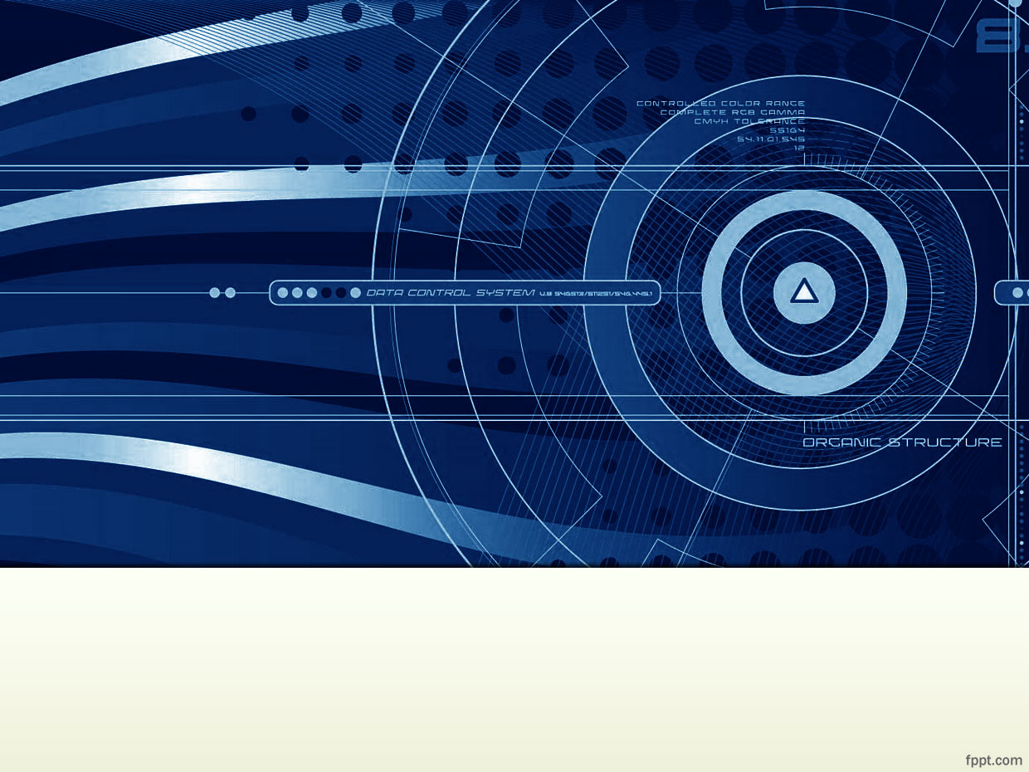
A Guide to Computer User Support for Help Desk and Support Specialists
Chapter 10
Presented By:
Heather Fleming
Tara Scarborough
Tiffany Worley
Notes:
Needs have been assessed, products evaluated, and a system has been purchased. Now it’s time to install it.

Slide 2
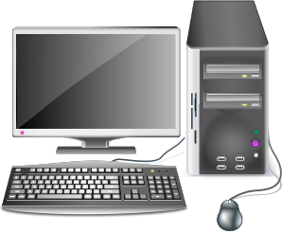


System Installation
New System or Replacement
Openclipart.org
Notes:
Whether this is a new system or a replacement,

Slide 3
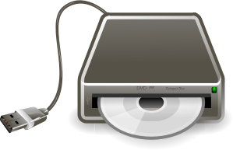
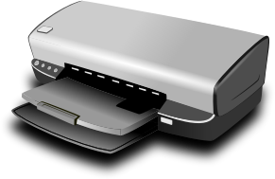
System Installation
New System or Replacement
Printer, Scanner, other hardware
Openclipart.org
Notes:
A printer, a scanner, or other hardware,

Slide 4



System Installation
New System or Replacement
Printer, Scanner, other hardware
Software upgrade
Openclipart.org
Notes:
or a software upgrade, it may be a quick setup or it may take several hours or days.

Slide 5




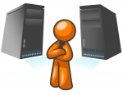
System Installation
Something out-of-the-ordinary?
Communicate with other departments
ClipartIllustration.com
Notes:
An install may only take one tech, or it may take a team of techs from several departments, depending on the complexity of the system. You will have to be prepared. Communicate! Have the proper tools. Have a plan. Use a checklist. The goal is to get the system and the user up and running as quickly, and painlessly, as possible.
So, where is this system going? This is one of the most crucial questions and hopefully this isn’t the very first time the subject has come up. Where should have been considered during the acquisition stage, so if this system does have any special requirements, they've been allowed for.

Slide 6
System Installation: Site Visit
Location, Location, Location
Personally visit install site
Notes:
Just like in real estate, location location location. The best way to find out what the setup needs will be is with a site visit. Don't depend on somebody else to tell you what they need. Go see it for yourself. End users forget the obvious like enough power outlets or needing a modem line.

Slide 7
System Installation: Site Visit
Location, Location, Location
Personally visit install site
Check space requirements
Notes:
If this system is a replacement for an older one, there’s a good chance the new one will fit where the old one was, but that’s not always the case. The new system may have different electrical requirements, a different footprint, may need to hang on the wall whereas the last one sat on a table.

Slide 8
System Installation: Site Visit
Location, Location, Location
Personally visit install site
Check space requirements
Check distances
Notes:
A standard desktop PC will need to be within four to five feet of the user's work area so that the monitor and other cables will reach. The user may want it even closer if they use the USB slots, the optical drive, or headphones a lot. A laptop may not have such constraints, but all systems give off heat and all will need plenty of room for ventilation.

Slide 9
System Installation: Site Visit
Location, Location, Location
Personally visit install site
Check space requirements
Check distances
Floor install – will it be safe?
Notes:
Putting a system on the floor may get it out of the way if desk space is at a premium, but doing so brings it's own problems. Floor machines are subject to getting kicked, hit with the vacuum, flooding (don't think it can't happen), and they are dust magnets. Try to not set a machine directly on the floor, but up on a shelf a few inches off the floor, and out of the path of foot traffic, doors, and other hazards.

Slide 10

System Installation: Site Visit
Location, Location, Location
Display location
Notes:
The display screen needs to be at eye level or a little below to avoid neck strain. If desk space is at a premium, see if the monitor can be mounted on the wall or put on a shelf. If the monitor is not a flat screen, a monitor arm could be used to hang it on the wall.

Slide 11
System Installation: Site Visit
Location, Location, Location
Display location
Peripherals
Notes:
The work surface of a typical office desk is about 30 inches high. Unfortunately, keyboards and mice need to be used at about 27" high. It will depend on the user, and their chair, and what-not, but the user's wrists need to be straight, with the forearms tilting downward slightly if at all possible. Otherwise, the user may develop pain in their wrists or fingers. Make sure to take into account the thickness of a laptop, and its docking station if there is one, when measuring.

Slide 12
System Installation: Site Visit
Location, Location, Location
Display location
Peripherals
Chair vs desk height
Notes:
To achieve a comfortable height, see if the desk can be shortened or the chair raised. If not, see if a keyboard tray can be installed under the desk. If the chair is raised, make sure the user's feet can still comfortably sit flat on the floor. If not, the user may develop leg problems.

Slide 13
System Installation: Site Visit
Location, Location, Location
Display location
Peripherals
Chair vs desk height
Printer placement
Notes:
A desktop printer may take up too much work space and need to be positioned on a nearby table or printer stand. Cables may need to be extended or may be completely in the way. Here is where wireless can come in quite handy. If the user prints frequently, the printer may need to be kept within arm's reach. Space will need to be allocated for printing supplies, as well.

Slide 14
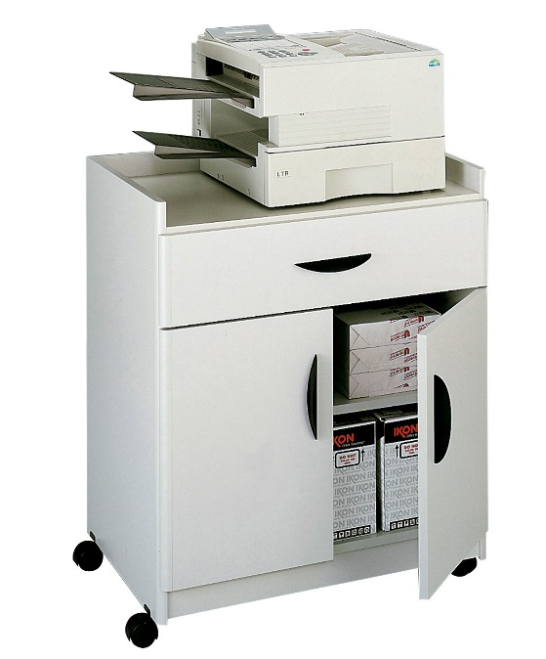
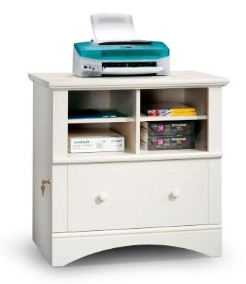
System Installation: Site Visit
Location, Location, Location
Available to everyone
Near power and network outlets
Room for supplies
Notes:
If the printer is being installed as a network printer for a group, it will need to be out in the open in a place convenient to everybody, not stuck in somebody's cubicle where they will be disturbed and have to chat with every person picking up a printout. There will need to be a power outlet nearby and a network jack, unless it is a wireless installation. Supplies should be kept close at hand, especially paper, for a group printer. Printer stands that are also cabinets, or locating the printer on top of built-in cabinets will solve this problem.

Slide 15
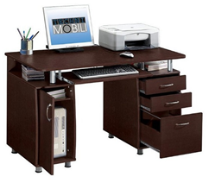
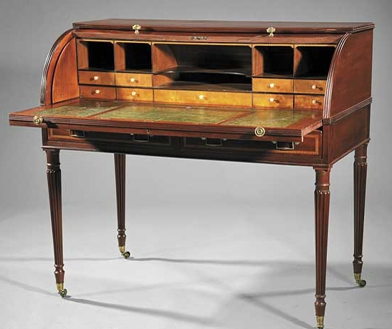
System Installation: Site Visit
Furniture
Notes:
Using furniture designed for computers and printers is the simplest answer. Surface heights are at comfortable levels, chairs are designed to adjust comfortably to users' needs. Shelving and drawers are designed with computer-use in mind. Trying to make any old piece of furniture work is a great exercise in frustration. They just are not designed for the task.

Slide 16
System Installation: Site Prep
Ergonomics
Study, design, and implementation of systems so that people can use them efficiently and safely.
Notes:
Ergonomics is the study, design, and implementation of systems so that people can use them efficiently and safely. The human body is not designed for long periods of sitting. It is not designed for minimal yet repetitive movements such as typing on a keyboard or using a mouse. Our eyes are not designed to stare at computer screens for long periods of time. After awhile, a worker will develop very serious pain and health conditions if precautions are not taken.

Slide 17
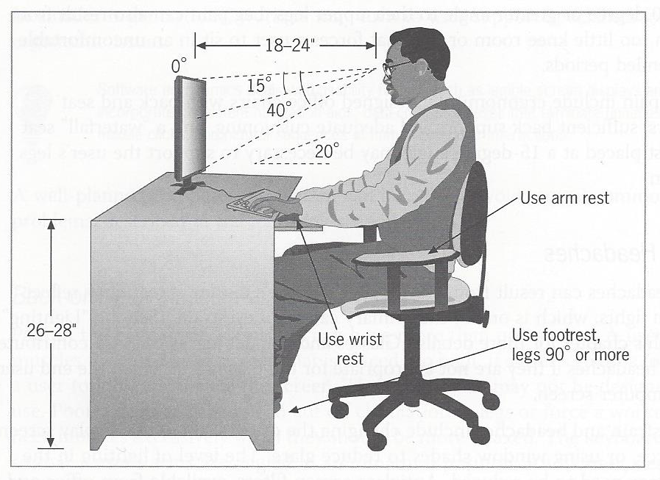
System Installation: Site Prep
Ergonomics
Wrist pain, finger and joint pain, carpal tunnel syndrome
A Guide to Computer User Support
Notes:
Carpal tunnel syndrome is a well-known repetitive strain injury. It affects the median nerve that runs from the forearm into the palm of the hand. This nerve gets pinched when a worker keeps their wrists bent while typing. Correct keyboard and mouse height are the biggest factors in avoiding this serious condition.

Slide 18
System Installation: Site Prep
Ergonomics
Wrist pain, finger and joint pain, carpal tunnel syndrome
Back and neck pain
Leg pain
A Guide to Computer User Support
Notes:
Back or neck pain can be a result of having to constantly tilt the head up or down to see the monitor. It can also be from a user's chair that may not allow for adjustment. Chairs designed for computer use allow the seat height to be adjusted, have arm and back rests, swivel, tilt, and have rollers to allow for easy movement, all things that aid correct posture and user comfort. A chair that doesn't allow the user's feet to rest comfortably, flat on the floor can impair circulation and cause leg pain.

Slide 19
System Installation: Site Prep
Ergonomics
Wrist pain, finger and joint pain, carpal tunnel syndrome
Back and neck pain
Leg pain
Eye Strain, headaches
A Guide to Computer User Support
Notes:
Staring at a computer screen for long periods of time can cause eye strain and headaches, especially when the screen has a lot of glare, or light reflecting off of it. Try to orient the screen 90 degrees to a bright window. Don't have the screen in front of a window, either, as the backlight from the window will also cause eyestrain. Use curtains or shades on extremely bright windows. Use reduced lighting in computer areas or use anti-glare screen filters on individual display screens.

Slide 20

System Installation: Site Prep
Ergonomics
JUST GET UP AND MOVE!
free-power-point-templates.com
Notes:
The simplest way to help avoid strains and injuries is to make sure workers get up and move once an hour.

Slide 21
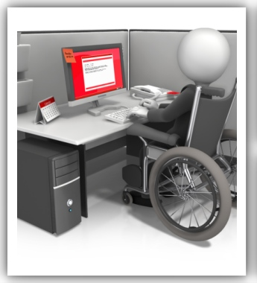
System Installation: Site Prep
Ergonomics
Software
  Convert words to speech
  Enlarging fonts
Hardware
  Special pointing devices
Wheelchair manueverability
free-power-point-templates.com
Notes:
Ergonomics also covers assistive devices -- software and hardware that can make a computer usable for those with a disability: Software that converts words on-screen to spoken text for someone who is blind, special pointing devices for those with limited movement. It also includes making sure there's room to get a wheel-chair up close to the desk or setting the fonts on the existing system to display extra large.
The user is going to be spending a large part of their life sitting at this work station. They need to be kept safe and made as comfortable as possible.

Slide 22
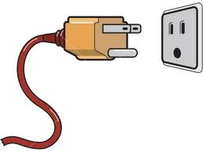
System Installation: Site Prep
Workstation Needs
Power
gopixpic.com
Notes:
We've covered the human part of the setup. Now what will the machine itself require? Well, obviously power. If this is a standard PC or laptop, a regular wall outlet or power strip will do. If it's a larger system or a custom installation, it may require more than a standard 120v wall outlet.

Slide 23
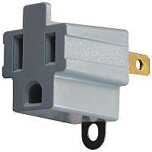
System Installation: Site Prep
Workstation Needs
Power
gopixpic.com
Notes:
If the building the system will be housed in is older, the wiring may not be up-to-date enough for a computer system. Two pronged outlets that don't allow for the third or grounding prong, or don’t accept the wide, orienting prong, are not healthy for computers. That third prong is there for a reason. And don't try to cheat with an adaptor plug. There’s no guarantee that what they’re grounding to is even actually grounded. Computers are very sensitive electronic devices.

Slide 24
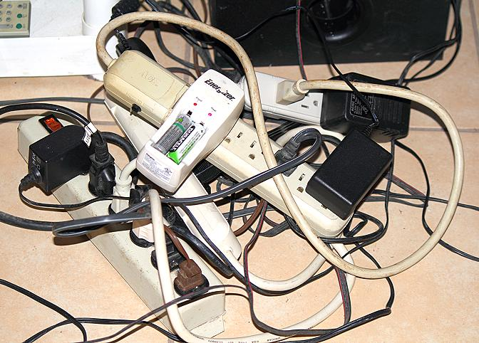
System Installation: Site Prep
Workstation Needs
Power
gopixpic.com
vivaveracruz.com
Notes:
Check to see if a power strip will be needed. Then don't fill it so full it looks like an escapee from a science fiction movie. Each device that will be plugged in will have a sticker or a plate on it somewhere that will tell how many amps the device draws. Add these up to see what the total draw will be. Make sure the power strip is rated for more than that amount. Also, make sure the power strip is plugged directly into a wall outlet and not another power strip.

Slide 25
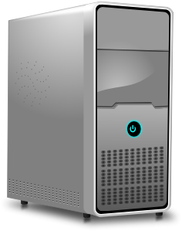
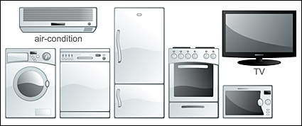

System Installation: Site Prep
Workstation Needs
CPU + Monitor + Printer
+ Anything else on the same circuit
----------------------------------------
Total Load
+
Clipartlogo.com
=
Total Circuit Load
Clipartillustration.com
Notes:
Take a look in the circuit breaker box and see how many amps the circuit breaker for this circuit can handle. Then allow for some extra, as most devices draw more amps on startup than they do during standard operation. Check to see if this circuit is shared with any other devices that will cause overload once the computer system is all hooked up. If so, move the computer to a different circuit. If many computers are to be grouped together in the same location, total power requirements will need to be planned for ahead of time. New wiring may be required to handle the load.
Also, don't share the computer system on a circuit with something big enough to cause the lights to dim when it comes on. That's called a brownout and it means the available current is being drawn down below an acceptible level. A brownout can damage your electronics just as much as too much power can. If the install location has brownouts, it will be worth the expense to get a power conditioner. That will supply a steady, clean supply of power to your computer system. It must be rated to handle the total electrical load of everything plugged into it.

Slide 26
At this point, Powerpoint couldn’t handle the strain anymore and kept crashing. The narration stops here, but the presentation continues for 7 more slides. Please turn on the notes to view what Powerpoint wanted to keep secret.

Slide 27
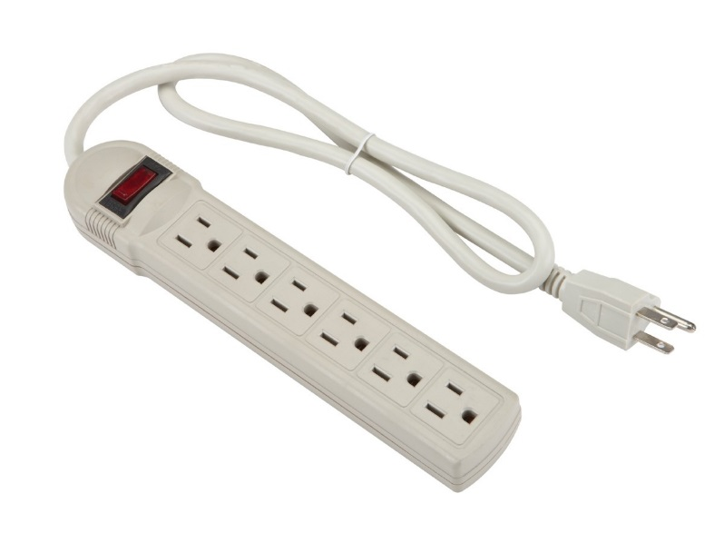
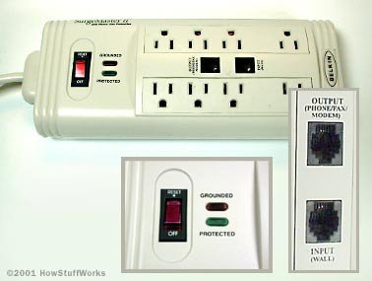
System Installation: Site Prep
Workstation Needs
Power Strip Surge Protector
Harborfreight.com
HowStufWorks.com
Notes:
The opposite of a brown out is an electrical surge or a spike. A spike is very short (timed in milliseconds), but very high in voltage. A surge lasts longer (maybe even as much as a few minutes) but is nowhere near as high in voltage as a spike. To protect against these dangers, a surge protector can be purchased. That is a special type of power strip that helps protect your computer equipment. Some companies back their surge protectors with a warranty that will pay the user if their equipment is damaged by an electrical surge or spike, even if it was a lightning strike!

Slide 28
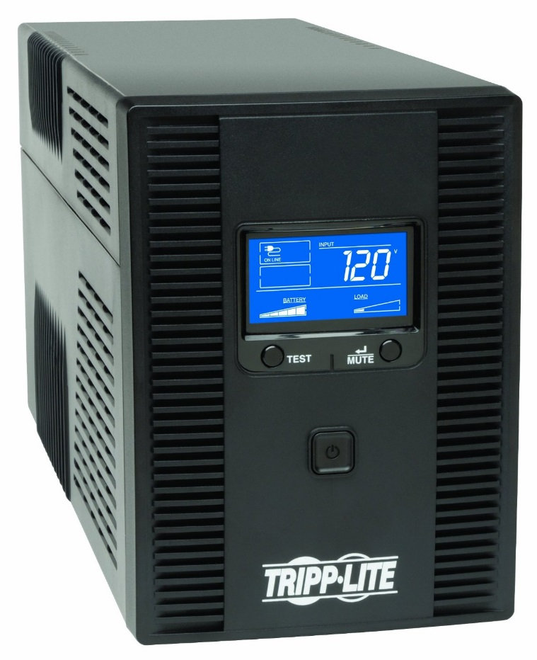
System Installation: Site Prep
Workstation Needs
Uninterruptible Power Supply (UPS)
Battery backup
Power conditioner
Amazon.com
Notes:
Another useful piece of equipment is an uninterruptible power supply, or UPS. A UPS is a power conditioner that also has batteries in it. When the main power is interrupted, the batteries kick in and supply power. Since the major expense in a UPS is the batteries, the more battery capacity, the greater the expense. So, most UPS's are small boxes that fit under a desk, or in a closet. They aren't meant to run everything computer related in the office until the power comes back on. They're meant to give you time to shut down all your devices properly, avoiding hard drive crashes and data loss.

Slide 29
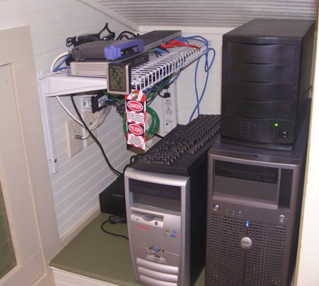
System Installation: Site Prep
Workstation Needs
Checklist:
Power outlets
Phone/Cable Jacks
Network Jacks or Wi-fi
Ventilation
118henrystreet.net
Notes:
While looking for outlets, also check that there will be enough network jacks and phone jacks nearby. Or will this machine access the network wirelessly, in which case, is there a strong enough signal at the install location?
While a standalone PC or laptop won't generate enough heat to overrun the location's cooling system, if several machines or large servers are put in a small area, they may, especially if the server is crammed in a closet somewhere out of the way. Most places don't put air vents in their closets, so pay attention when scoping out where this system is going.

Slide 30
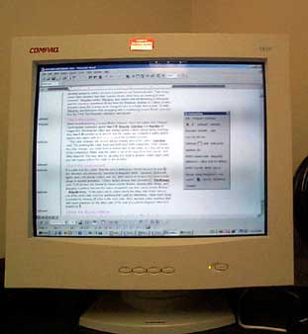
System Installation: Site Prep
Workstation Needs
Lighting
Too bright
Screen glare
Screen flicker
Techrepublic.com
Notes:
Be aware of how bright the lights in the area are. Too bright of a light will cause glare on the computer screens. See if the lights can be adjusted. Also, be aware of what type of lights and what type of monitors will be used. Fluorescent lights flicker. No, not that annoying off and on flicker you see when the ballast or bulb is going bad. They flicker at an imperceptible rate due to the charged mercury gas in them. Sometimes the flicker rate is the same as the refresh rate of the computer monitor and it causes a scan line to constantly scroll up the screen. This only happens with some CRT monitors because of the way they display pictures on their screen. It doesn't happen with newer LCD/LED screens.

Slide 31
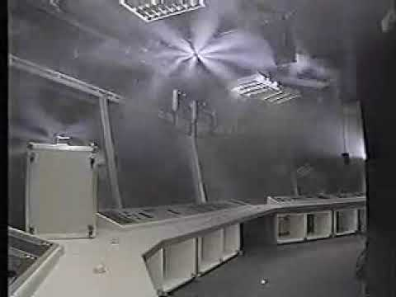
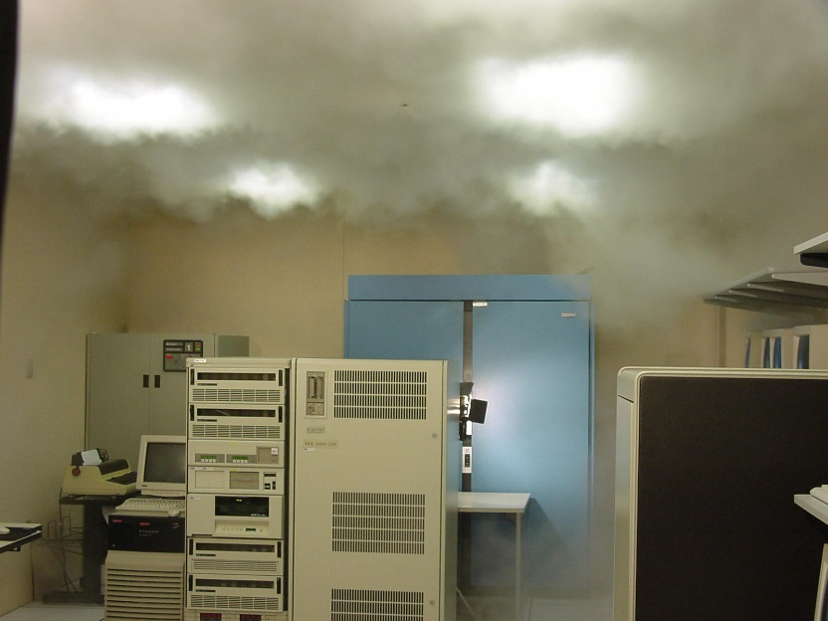
System Installation: Site Prep
Workstation Needs
Fire Suppression
No water sprinklers!
Inert gas or Halocarbon
Youtube.com
Wikipedia.com
Notes:
Finally, look overhead and see what type of fire suppression is used at the install site. Sprinkler systems may save the building, but they'll ruin a $100,000 worth of computer equipment and all the company's data real quick. If the area is small, it may be better to have a portable fire extinguisher on hand. Make sure it's rated for electrical fires, otherwise, it will cause the same problem. If it is a large or commercial area, make sure the sprinklers use halocarbon or an inert gas as the fire suppressant.

Slide 32
System Installation: Site Prep
Site Management Documentation
Track:
Hardware configuration
Software configuration
Network connection details
Application software and accompanying licenses
Problem log history
Purchase date
Etc.
Notes:
Something most smart businesses do is keep documentation on their computers: the hardware configuration, the software configuration, network connection details, application software and accompanying licenses, and the problem logs, for each machine. This is important information that can save much time and trouble when it's time for diagnosing problems or doing upgrades.
It may sound like overkill for a home user, but even they can benefit greatly from having all this information stored in one easy-to-reach place. At home, it may be smart to keep this information in a notebook, since if it was on the computer's hard drive, it would be lost in a system crash, just when it was needed most.

Slide 33
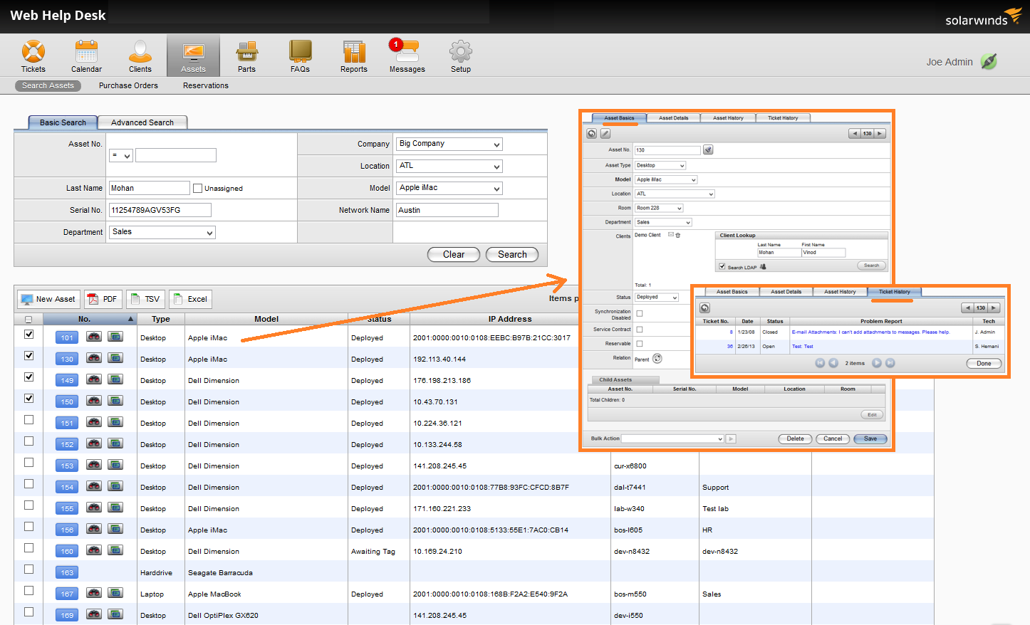
System Installation: Site Prep
Site Management Documentation
Notes:
For larger installations though, this type of information is kept in a database. Whenever a tech does an install, he updates the database with all the pertinent information about the new system. Many techs consider it just a hassle, but the more information that can be kept in the database, the more help it can be when a computer has to be repaired or an upgrade is rolled out company wide. Suppose the boss wants to know how many machines in your 150-seat call center are over four years old because they're thinking about buying new machines? Would you rather go boot up and hand check 150 machines, or would you rather point, click, and print him a report? However, the documentation will only be as good as what gets put in it. It has to be kept current, and it has to be filled out as completely as possible. Otherwise, it will be just a time-waster that doesn't do anybody any good.

Slide 34
System Installation: Site Prep
Summary
Site visit to check on
Location of system, monitor, peripherals, printer
Furniture required
Any out-of-the-ordinary needs
Consider ergonomics:
Monitor level
Keyboard and mouse height
Chair
Disability needs
Investigate:
Power requirements and availability
Network, telephone needs
Ventilation
Lighting
Fire Suppression
Don’t forget to document!
Notes:
Summary
So, in summary, you should do a site visit that includes checking about:
Location of the system, the monitor, peripherals, furniture required, and other out-of-the ordinary needs.
Think about ergonomics when planning the install: monitor level, keyboard and mouse height, comfortable chair,
Make sure to investigate: power requirements and availability, network and telephone needs, ventilation, lighting, andfire suppression.
Keep the Site Management Documentation updated!
Hopefully, surprises will be kept to a minimum.

