Slide 1
Chapter 10
Tiffany Worley
Heather Fleming
Tara Scarborough

Slide 2
Media backup
Copying files
Reduced problems and cost of lost items
Internet providers offer free backup

Slide 3
Potential security threats
Security features, very sophisticated
Access date anywhere on a network
Support specialist are always monitoring network performance

Slide 4
Electronic threats
Worms
Viruses
Trojan horses
Can overload your network

Slide 5
Physical threat
Reduce threat and sabotage
Equipment to reduce loss
Id cards, motion sensors and physical barriers

Slide 6
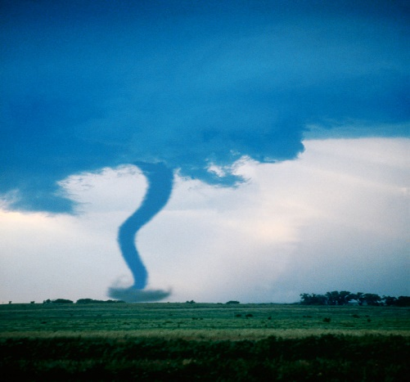

Disaster and Contingency
Natural disaster
Fires, floods, tornados and power outages
Insurance helps to restore lost items

Slide 7

Preventative maintenance
Is used to prevent computer maintenance
Cleaning is necessary
Isopropyl alcohol and a microfiber cloth used for cleaning

Slide 8

Disk drivers
Can be replaced
Hard disc, DVD, CD and any removable disc

Slide 9
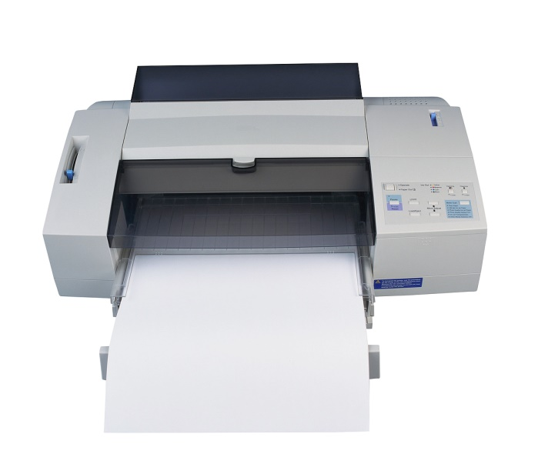
Printers
A computer plugin
Needs cleaning to prevent dust buildup

Slide 10
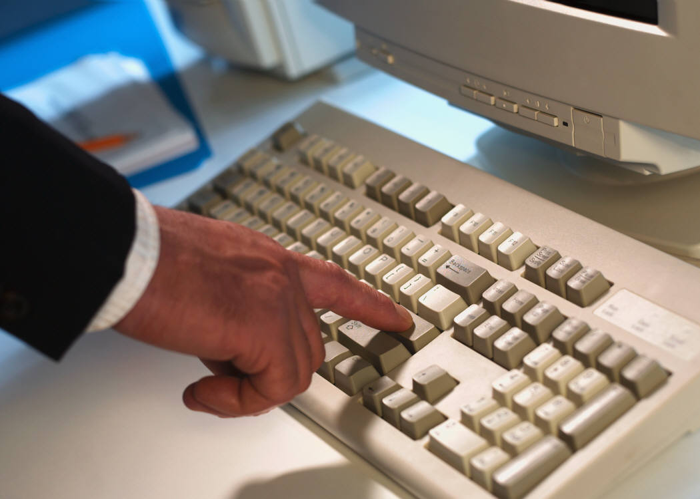
Keyboards
Also, a computer plug in
Required to enter
information into a computer
Needs cleaning by compressed air

Slide 11
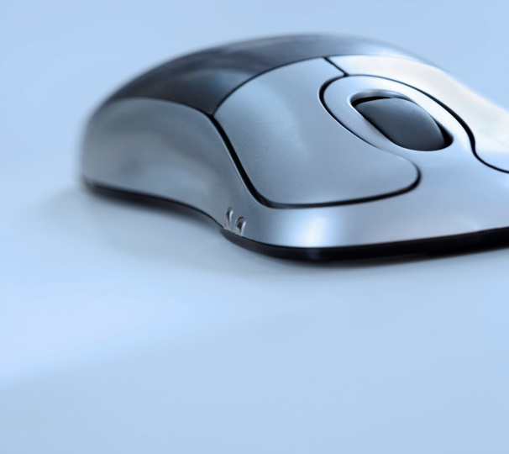
Mouse and track ball
Work together, hand in hand
Track ball needs to be cleaned
Trackball tracks movement
Mouse controls your selection

Slide 12
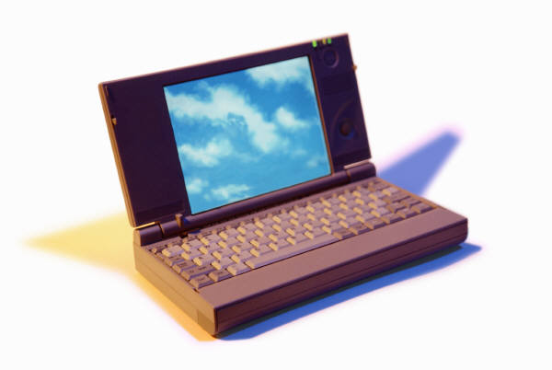
Display screen
Shows what is being displayed
The output of your computer

Slide 13

Supplies
Can be purchased at any office store
Includes, virus protections
Software
Microsoft office

